Slide 1
AI Fairness 360

Slide 2
What is AI Fairness 360?
An open source toolkit that can help explore some algorithmic bias and potential bias mitigation guides with the ultimate goal of enhancing machine learning models to be more equitable and less biased

Slide 3
Bias
Legal Definition of Bias?
Intentional Bias?
Unintentional Bias?
A systematic error. In the context of fairness, AI Fairness 360 is concerned with unwanted bias that places privileged groups at systematic advantage and unprivileged groups at systematic disadvantage

Slide 4
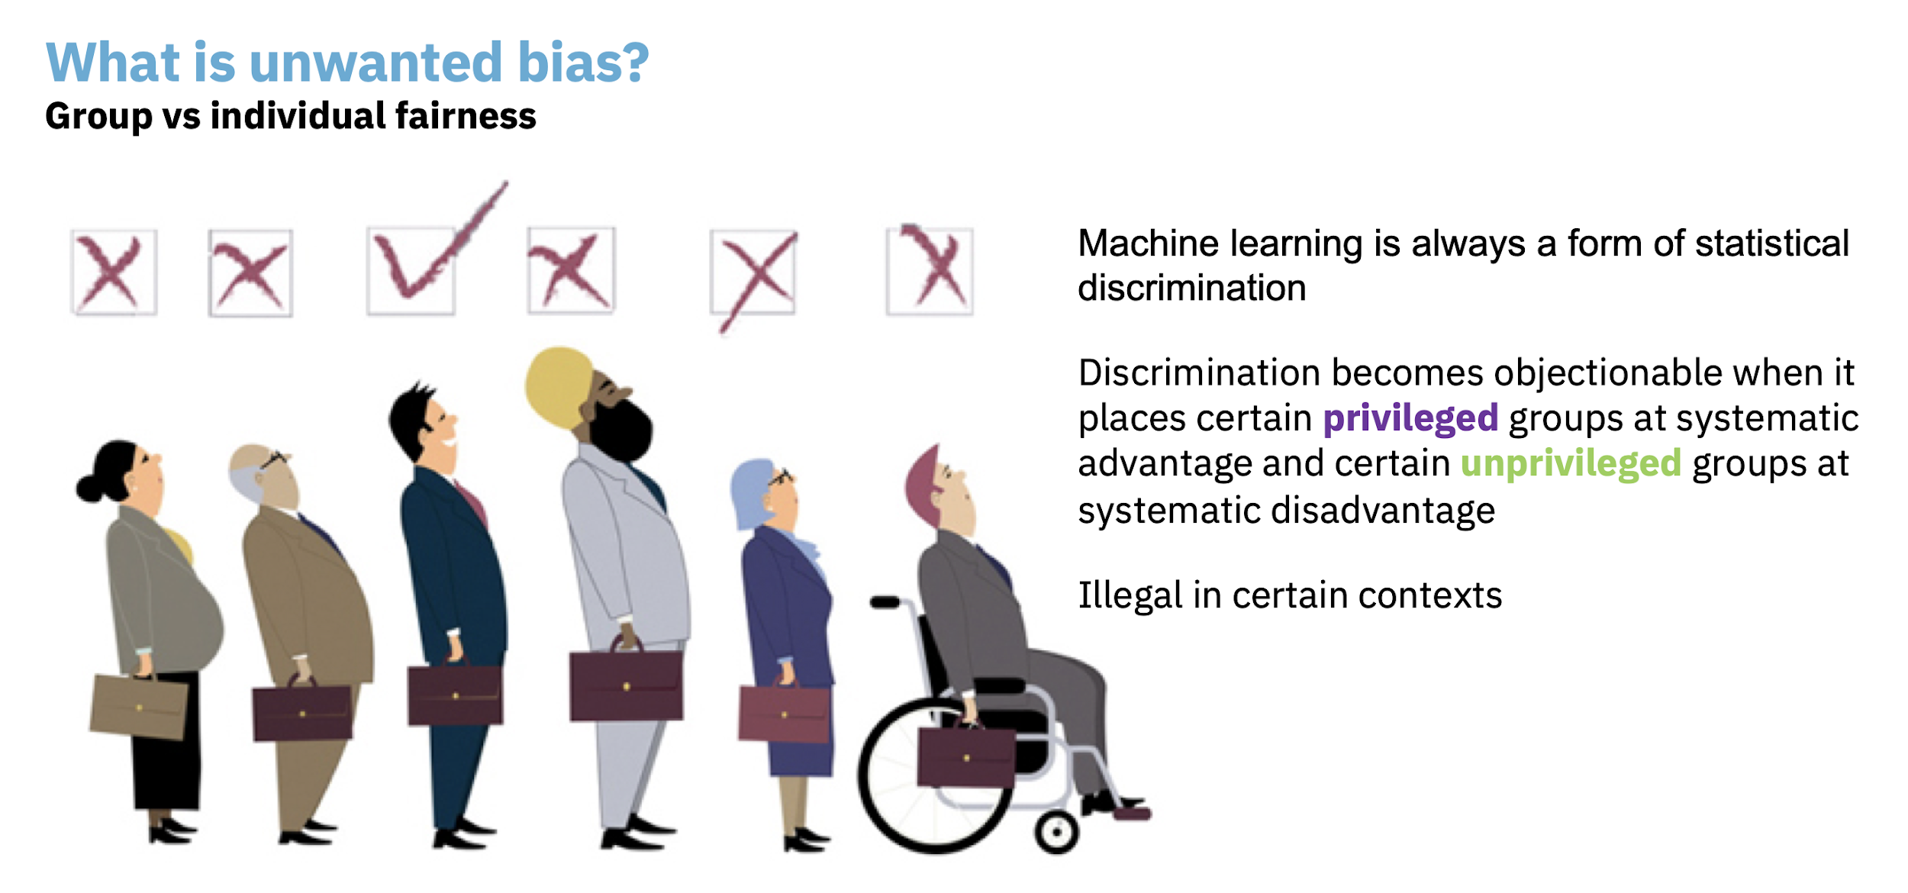

Slide 5
Group Fairness
race, gender, caste, religion,etc.
The goal of groups defined by protected attributes receiving similar treatments or outcomes

Slide 6
Individual Fairness
The goal of similar individuals receiving similar treatments or outcomes

Slide 7
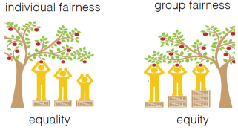

Slide 8
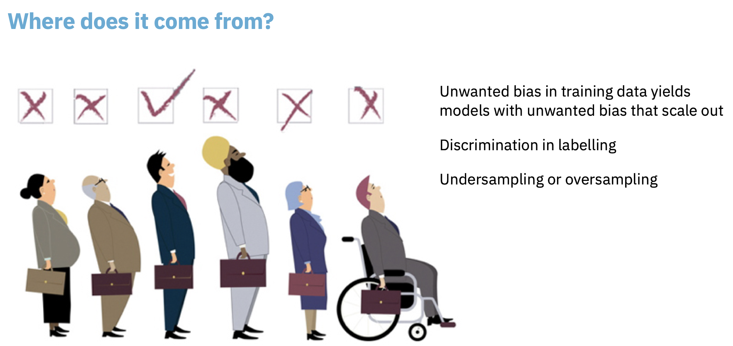

Slide 9
Fairness metric
Legal definition of fairness? How much fairness?
A quantification of unwanted bias in training data or models
Examples:
Mean Difference
Statistical Parity Difference
Equal Opportunity Difference
Average Odds Difference
Euclidean Distance[the distance between two points in any number of dimensions - the square root of the sum of the squares of the differences between the respective coordinates in each of the dimensions]
Manhattan Difference[the total sum of the difference between the x-coordinates and y-coordinates]

Slide 10
Bias Mitigation Algorithms
A procedure for reducing unwanted bias in training data or models
Examples:
Reweighing Algorithm
Prejudice Remover Algorithm
Optimized Pre-Processing
Adversarial Debiasing
Reject Option Classification
Learning Fair Representations

Slide 11
Different Bias Mitigation Algorithms Stages
Pre-processing algorithm: A bias mitigation algorithm that is applied to training data.
In-processing algorithm: A bias mitigation algorithm that is applied to a model during its training.
Post-processing algorithm: A bias mitigation algorithm that is applied to predicted labels.

Slide 12
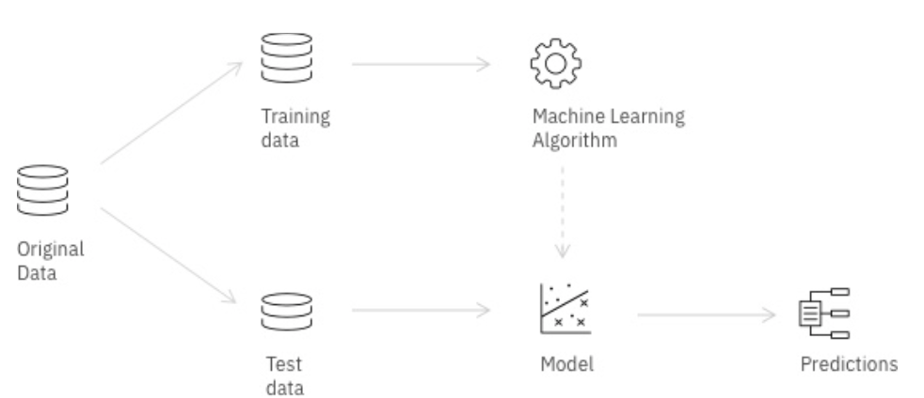
Pre-processing algorithm
In-processing algorithm
Bias
Bias
Biased Split of Original Data
Post-processing algorithm
Bias

Slide 13
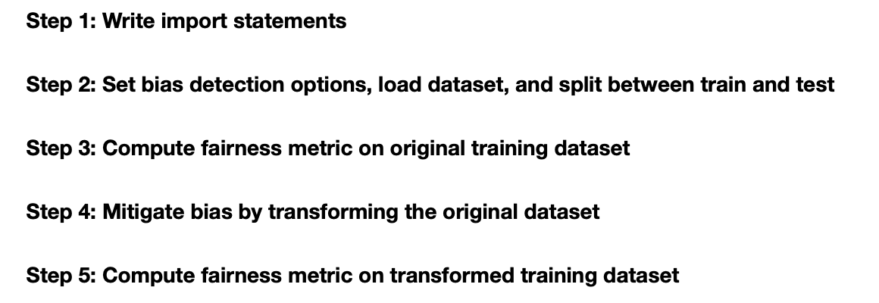
Using AI Fairness 360 Example: Detecting and mitigating age bias on credit decisions

Slide 14
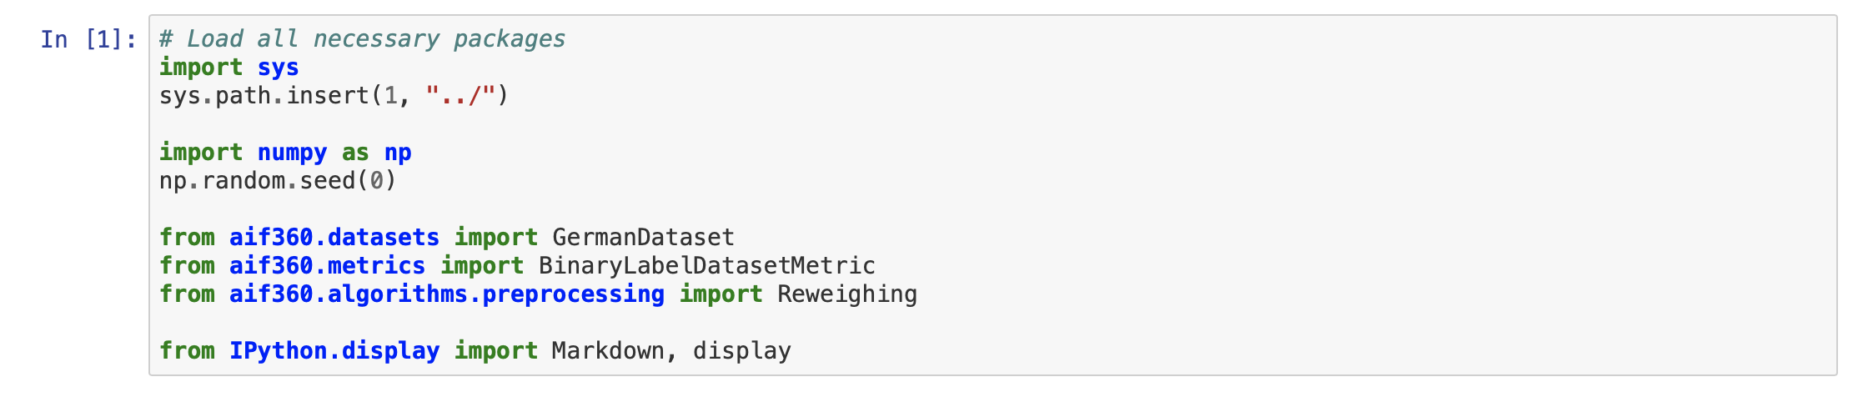
Step 1

Slide 15
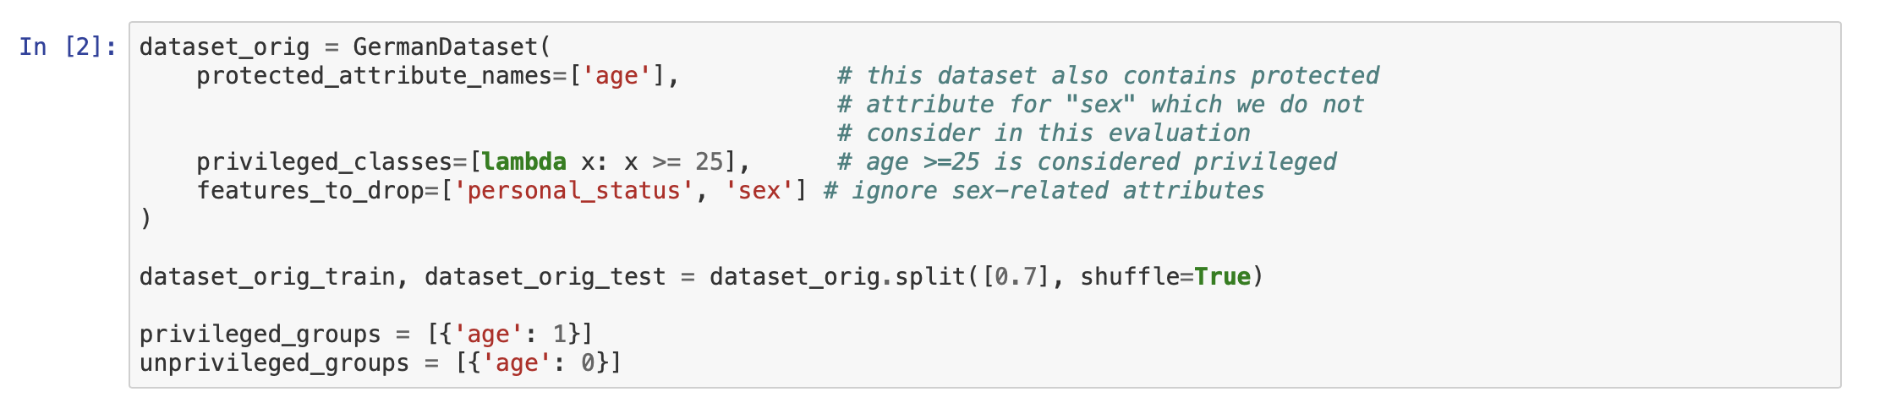
Step 2

Slide 16
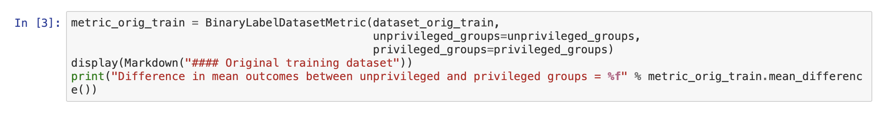
Step 3

Slide 17
Step 4

Slide 18
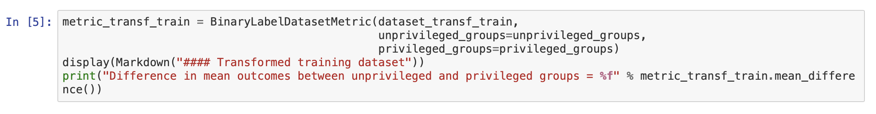
Step 5

Slide 19
Using AI Fairness 360

Slide 20
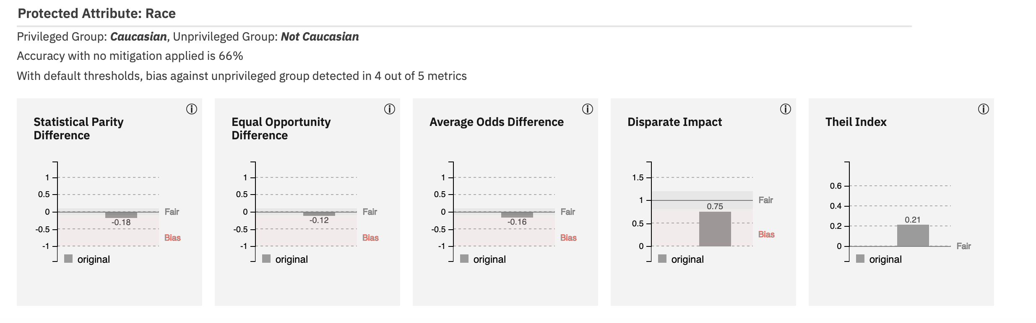
COMPAS Example
Correctional Offender Management Profiling for Alternative Sanctions(COMPAS)
a tool designed to assess offenders' criminogenic needs and risk of recidivism
Who chooses thresholds?
The Four-Fifths rule states that if the selection rate for a certain group is less than 80 percent of that of the group with the highest selection rate, there is adverse impact on that group
Checking the fairness metrics on protected attributes

Slide 21
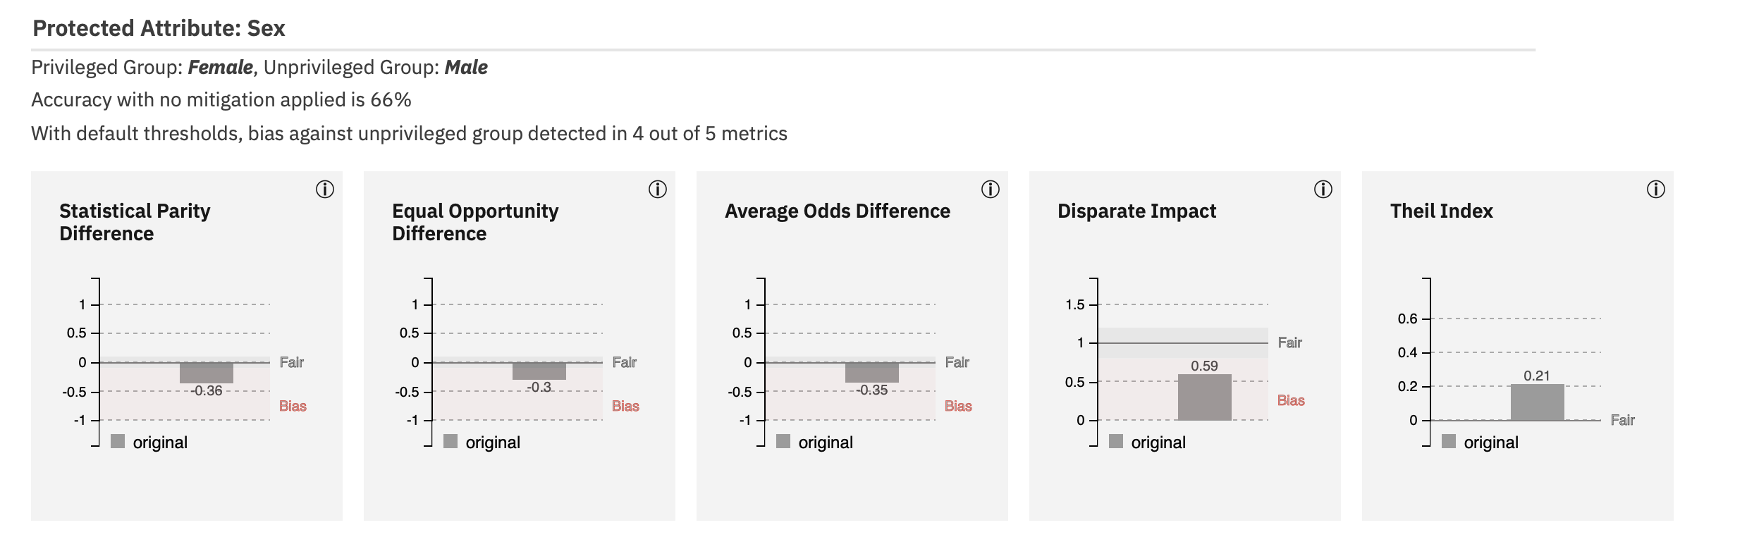

Slide 22
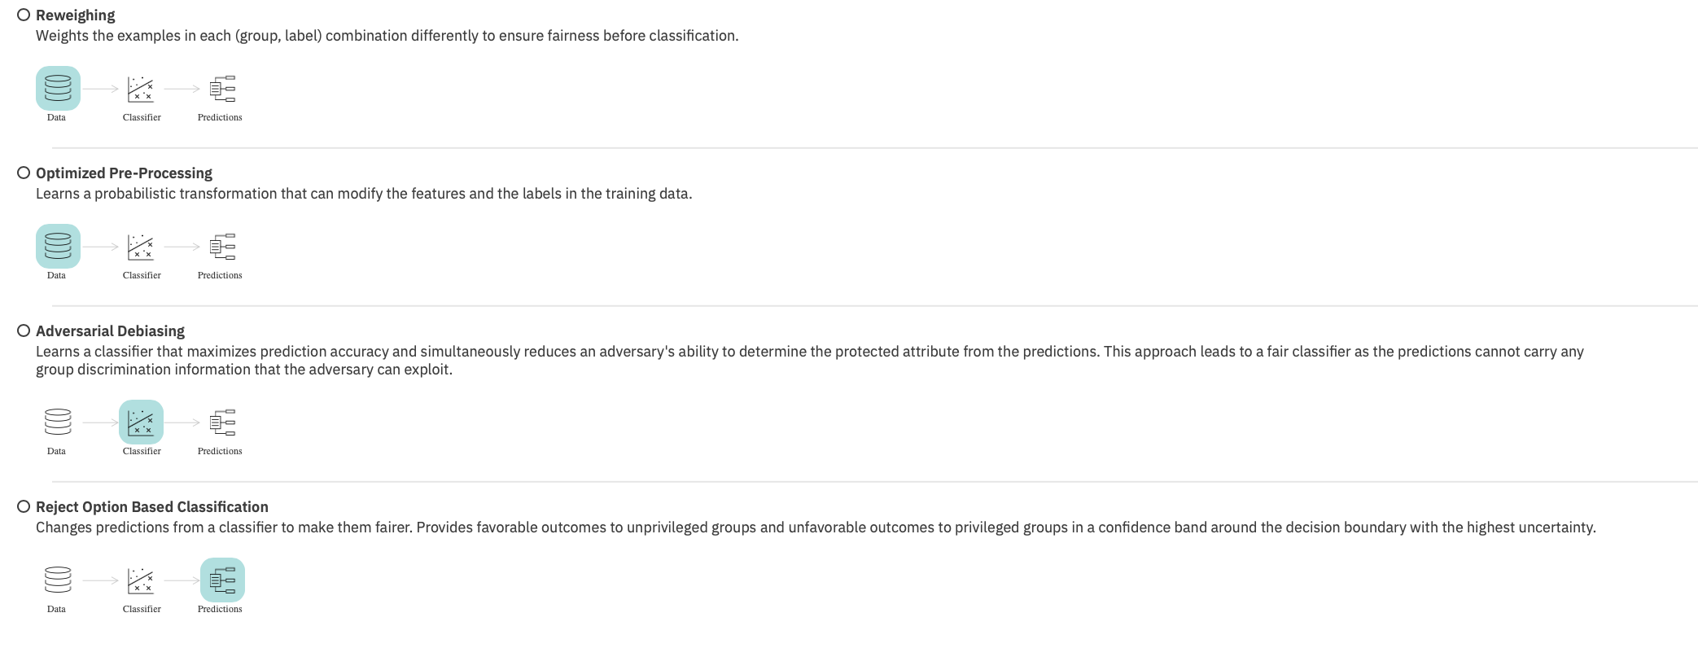
Pick a bias mitigation algorithm

Slide 23
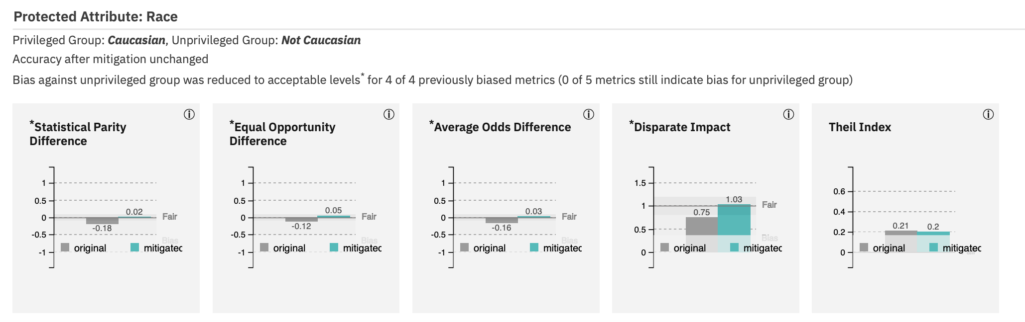
Reweighing Algorithm(Pre-processing; weighting differently)

Slide 24
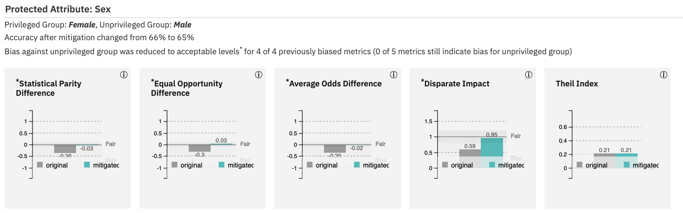

Slide 25
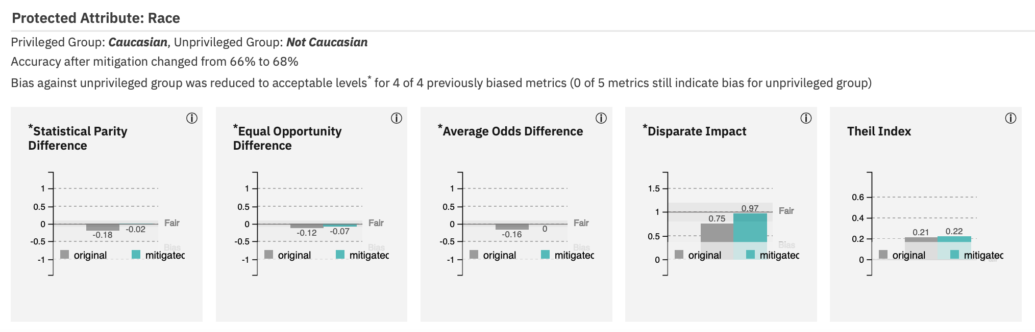
Optimized Pre-processing Algorithm(Pre-processing; tries to transform training data labels)

Slide 26
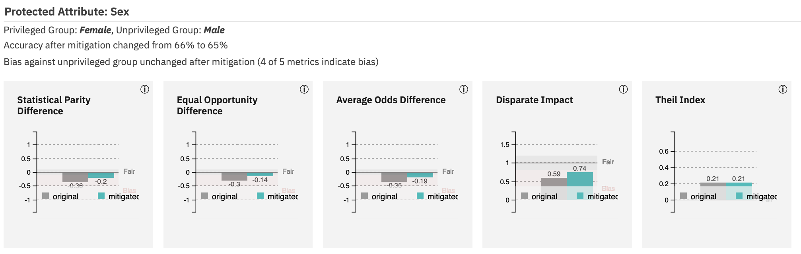

Slide 27
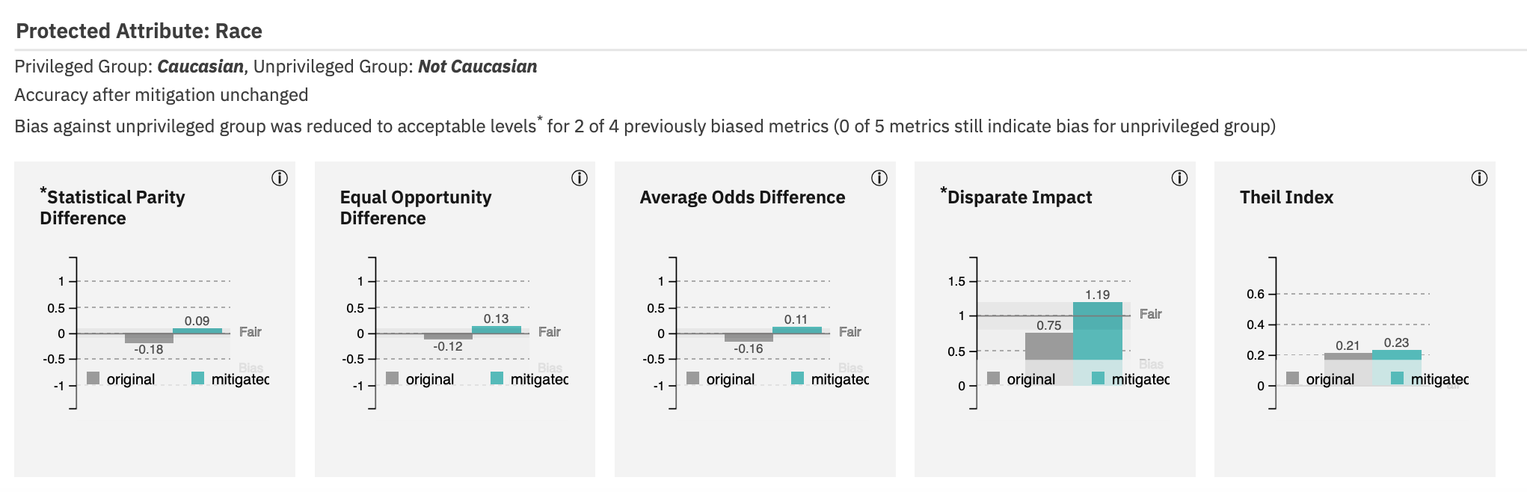
Adversarial Debiasing Algorithm(In-processing; helpful for group discrimination)

Slide 28
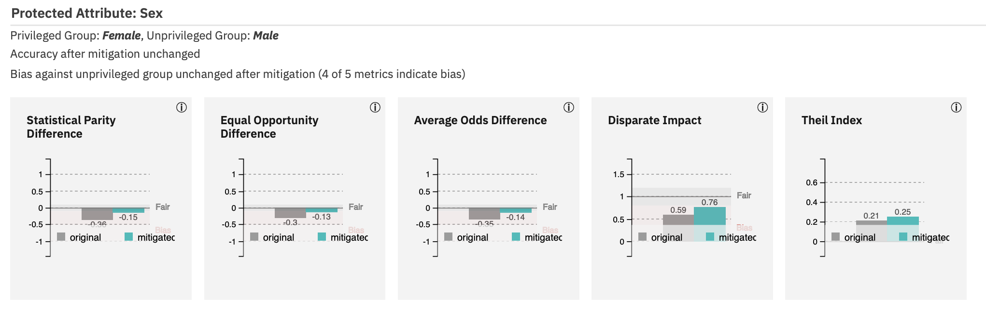

Slide 29
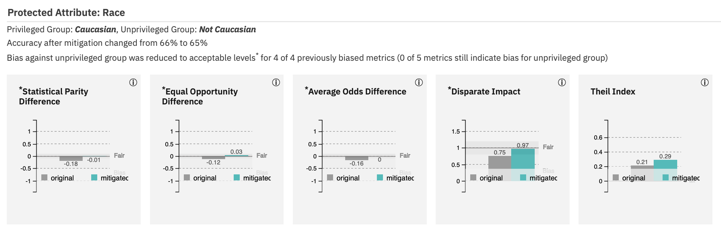
Reject Option Based Classification Algorithm(In-processing; helpful for group discrimination)

Slide 30
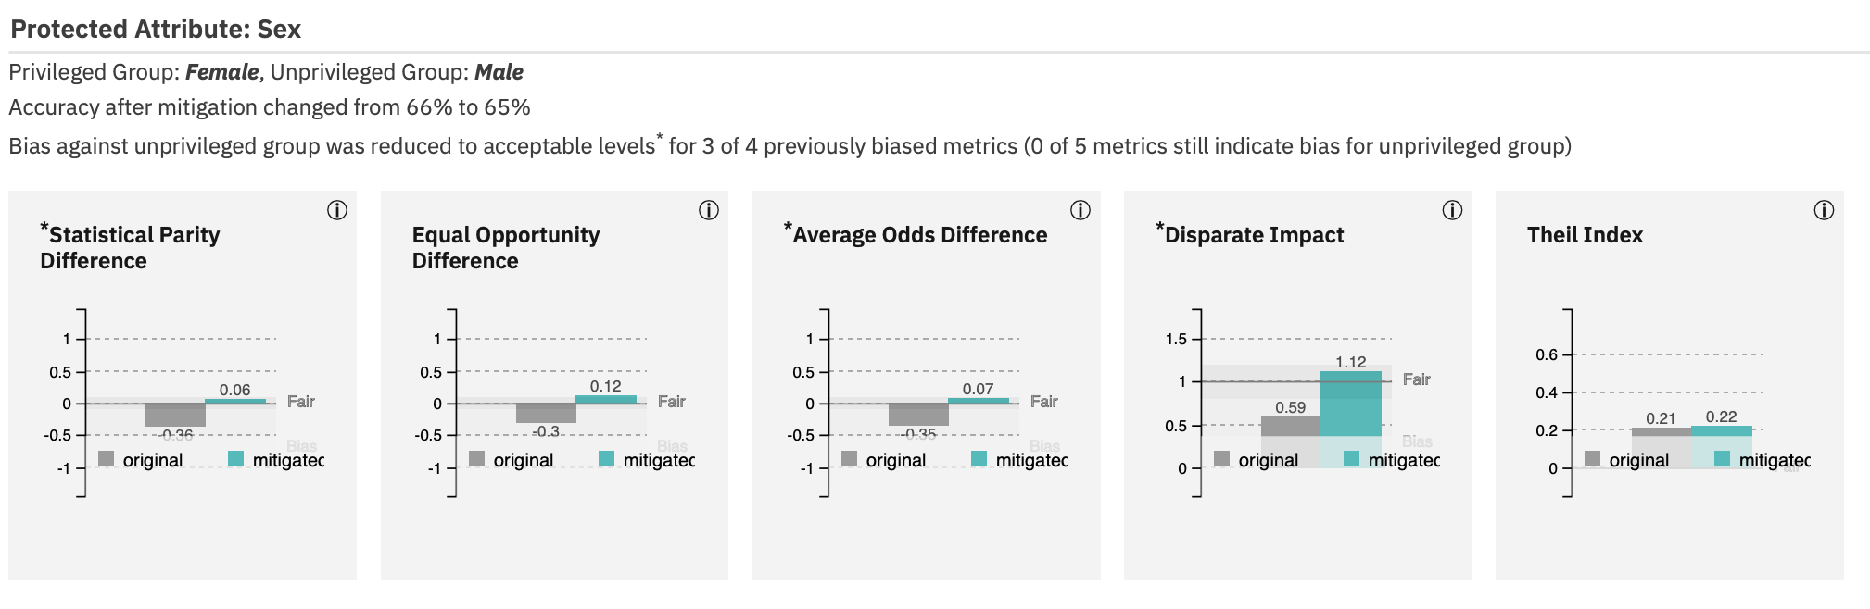

Slide 31
COMPAS Dataset
Pre-processing data to get it into the right format
For AI Fairness 360 can also probably be a source of
Introduced bias
ProPublica
database extension
compas.db: a sqlite3 database containing criminal history, jail and prison time, demographics and COMPAS risk scores for defendants from Broward County, Florida
compas-scores-raw.csv: raw compas scores
...and other supplemental data, such as compas-scores-two-years.csv, compas-scores-two-years-violent.csv
“comma-separated values” = csv(“tabular data”)

Slide 32
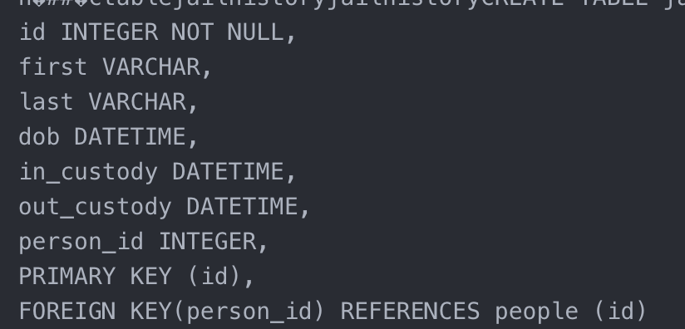
compas.db:
The database has many tables, including some for jailhistory, prisonhistory, casearrest,summary, people charge, and compas.
Some jailhistory table data

Slide 33
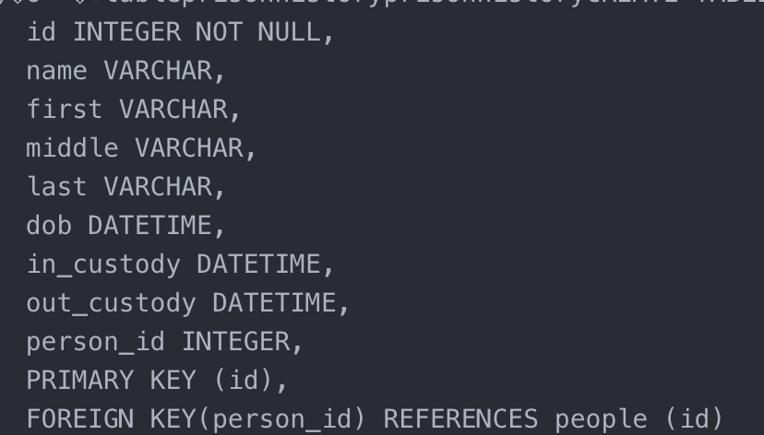
Some prisonhistory table data

Slide 34
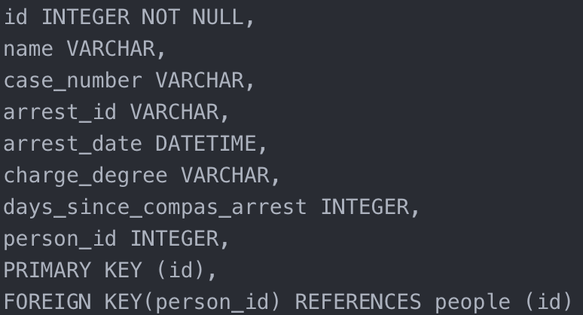
Some casearrest table data

Slide 35
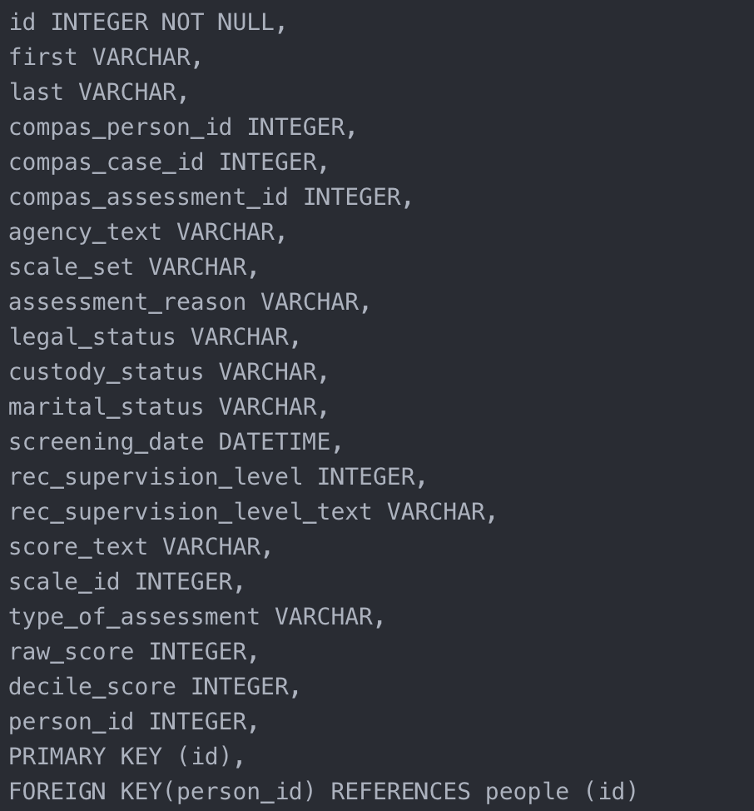
Some compas table data

Slide 36
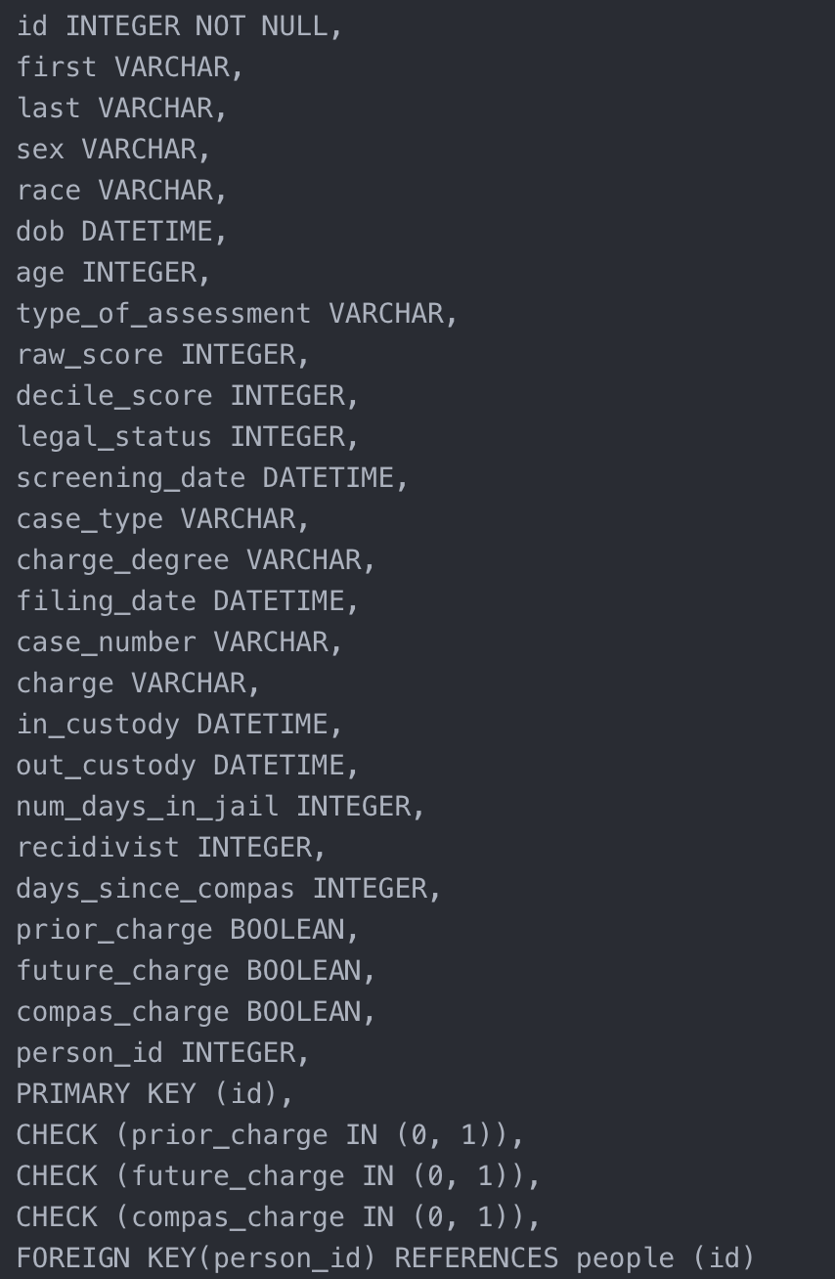
Some summary table data

Slide 37
id,name,first,last,compas_screening_date,sex,dob,age,age_cat,race,juv_fel_count,decile_score,juv_misd_count,juv_other_count,priors_count,days_b_screening_arrest,c_jail_in,c_jail_out,c_case_number,c_offense_date,c_arrest_date,c_days_from_compas,c_charge_degree,c_charge_desc,is_recid,num_r_cases,r_case_number,r_charge_degree,r_days_from_arrest,r_offense_date,r_charge_desc,r_jail_in,r_jail_out,is_violent_recid,num_vr_cases,vr_case_number,vr_charge_degree,vr_offense_date,vr_charge_desc,v_type_of_assessment,v_decile_score,v_score_text,v_screening_date,type_of_assessment,decile_score,score_text,screening_date
compas-scores.csv
ProPublica
Setup of categories
Entry #1 of 11757 Entries
1,miguel hernandez,miguel,hernandez,2013-08-14,Male,1947-04-18,69,Greater than 45,Other,0,1,0,0,0,-1,2013-08-13 06:03:42,2013-08-14 05:41:20,13011352CF10A,2013-08-13,,1,F,Aggravated Assault w/Firearm,0,,,O,,,,,,0,,,,,,Risk of Violence,1,Low,2013-08-14,Risk of Recidivism,1,Low,2013-08-14
Notes:
11757

Slide 38
Person_ID,AssessmentID,Case_ID,Agency_Text,LastName,FirstName,MiddleName,Sex_Code_Text,Ethnic_Code_Text,DateOfBirth,ScaleSet_ID,ScaleSet,AssessmentReason,Language,LegalStatus,CustodyStatus,MaritalStatus,Screening_Date,RecSupervisionLevel,RecSupervisionLevelText,Scale_ID,DisplayText,RawScore,DecileScore,ScoreText,AssessmentType,IsCompleted,IsDeleted
compas-scores-raw.csv
Setup of categories
Sample Entry
50850,57176,51958,PRETRIAL,Debe,Mikerlie,George,Female,African-American,10/09/94,22,Risk and Prescreen,Intake,English,Pretrial,Jail Inmate,Significant Other,1/1/13 0:00,2,Medium,7,Risk of Violence,-1.29,7,Medium,New,1,0
Notes:
11757

Slide 39
Problem with Bias Mitigation
Cannot simply drop protected attributes because features are correlated with them
Sensitive Attributes
Issues with Disparate Impact(“unintentional discrimination”) due to the fact that attributes are correlated to many other attributes and are virtually interlinked

Slide 40
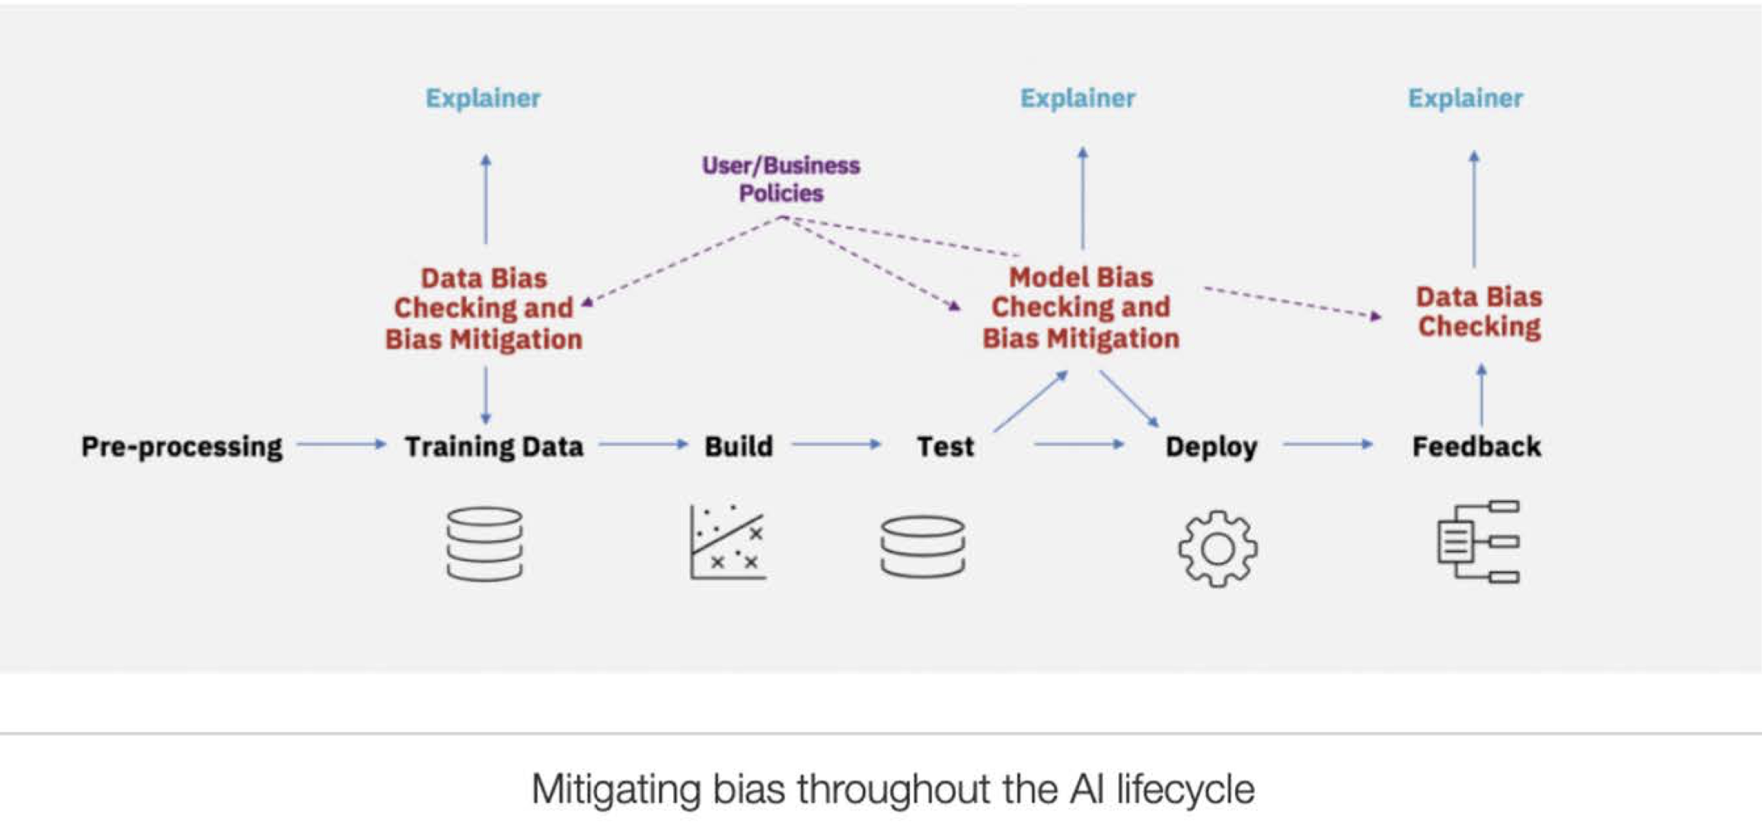

Slide 41
Observations/Assumptions
There is no one definition of fairness applicable in all contexts.
There should be a comprehensive set of fairness metrics and bias mitigation algorithms.
If the user is allowed to modify the training data, then pre-processing can be used. If the user is allowed to change the learning algorithm, then in-processing can be used. If the user can only treat the learned model as a black box without any ability to modify the training data or learning algorithm, then only post-processing can be used.
There is no one best algorithm independent of dataset.

Slide 42
How Well Does This Stuff Work?
Probably well...depending on dataset, choice of algorithm, etc.

